Slide 1
BIS3214 – Data Warehousing &
Business Intelligence
Joanna Loveday
School of Science and Technology
j.loveday@mdx.ac.uk

Slide 2
Module Context
Developing a Data warehouse for decision support and strategic planning has now become a most desirable objective for business organisations
A data warehouse is a (large) collection of data specifically designed and optimised to support decision-making & analysis
A data warehouse, incorporating business intelligence, enables business organisations to discover new patterns and new phenomena in data in order to obtain analytical insight into business challenges
Intelligence: here, we mean background information, hidden information/knowledge
  Think of MI5, CIA, Spooks, etc.

Slide 3
Module Aim
The aim of this module is to develop an appreciation and understanding of the techniques and approaches used to develop and deploy a data warehouse for purposes of business intelligence.
Examine data quality and data transformation methods and practices, in addition to data warehousing modelling techniques, in order to build a quality data warehouse.
Information retrieval, data presentation and pattern recognition techniques that facilitate and support business intelligence applications.

Slide 4
Learning Outcome: Knowledge
Analyse the industrial data resource architecture, management process for information resource integration and the process of establishing data relationship in order to build data warehouse that assists management in decision making process
Reflect on recent data discovery strategies in order to recommend an appropriate method for incorporating business intelligence in industrial information resources
Review the recent business intelligence tools to carry out critical evaluation on methodologies and technologies available for information retrieval, data presentation, data visualisation and pattern recognition

Slide 5
Learning Outcome: Skills
Identify data cubes and multi-dimensionality in business information repository and apply the models to develop a quality data warehouse
Apply contemporary business intelligence technologies in order to develop intelligent information resources that enable users to view data patterns by deploying various tools

Slide 6
Coursework
This coursework is worth 100% of the overall grade.
The coursework consists of two parts:
  Stage 1 and Stage 2.
Stage 1 of the coursework involves data modelling, and no computer access is necessary to complete this part.
  Group (40%)
Stage 2 of the coursework is a computer-based practical assignment (data mining).
  Group and Individual (60%)

Slide 7
Module Information: More
Copy coursework from someone ??
  See University Plagiarism policy in students’ handbook
  Don’t forget to put references (follow specific guidelines for referencing)
  Acknowledge properly, since collusions are not accepted
  Make sure you have cited your references
Contents of the module: 2 main parts
  Large Database: Data Warehouse (focus)
  Business Intelligence: Data Mining components and applications (focus)
  Theoretical aspects of relational database (Overview)
General diagram of the module: see next slide

Slide 8
Introduction
DB Back-End
Business Intelligence
Large Data Management
Theoretical Aspects
of Relational DB
Business intelligence tools and methods.
Data Strategy and Data Warehousing
Example Relational DB: Oracle
Data visualisation and performance dashboard
Intelligent Database and Data Mining concept
Information presentation and executive decision making process

Slide 9
Reading Materials
Core Texts
Data Mining: Concepts and Techniques, Third Edition (2011), Jiawei Han, Micheline Kamber, Jian Pei, The Morgan Kaufmann Series in Data Management System. ISBN 13: 978-0-12-381479-1.
The Data Warehouse Toolkit: The Complete Guide to Dimensional Modeling by Ralph Kimball, Margy Ross,John Wiley & Sons; 2nd edition (2002) ISBN: 0-471-20024-7

Slide 10
Reading Materials
Core Texts
Building the Data Warehouse by William H. Inmon, John Wiley & Sons; 4th edition (2005) ISBN -13: 978-0-7645-9944-6
Dimensional Data Warehousing with MySQL (A Tutorial) [Kindle Edition, ~ £7] by Djoni Darmawikarta ISBN-13: 978-0-975218-2-0
Dr. Nawaz Khan, School of Computing Science
E-mail: n.x.khan@mdx.ac.uk
BIS4229 - Online Database Systems

Slide 11
Reading Materials
Additional Texts
Data Warehouse Design, Modern Principles and Methodologies, McGrawhill, Matteo Golfarelli, Stefano Rizzi, 2009, ISBN: 978-0-07-161039
Successful Business Intelligence: Secrets to Making BI a Killer App, By Cindi Howson, Edition: illustrated, Published by McGraw-Hill Professional, 2007, ISBN 0071498516, 9780071498517
Dr. Nawaz Khan, School of Computing Science
E-mail: n.x.khan@mdx.ac.uk

Slide 12
Additional Texts
Oracle Data Warehousing and Business Intelligence Solutions: With Business Intelligence Solutions, By Robert Stackowiak, Joseph Rayman, Rick Greenwald
Data mining for business intelligence: concepts, techniques, and applications in Microsoft Office Excel with XLMiner, By Galit Shmueli, Nitin R. Patel, Peter C. Bruce, Contributor Galit Shmueli, Nitin R. Patel, Peter C. Bruce, Edition: illustrated
Chen, Z; Intelligent Data Warehousing: From Data Preparation to Data Mining, , CRC Press, 2002, ISBN: 0849312043
Dimensional Data Warehousing with MySQL (A Tutorial) [Kindle Edition, ~ £7] by Djoni Darmawikarta
Dr. Nawaz Khan, School of Computing Science
E-mail: n.x.khan@mdx.ac.uk
BIS4229 - Online Database Systems

Slide 13
Database : Overview
File-based approach
Shared file approach
Database approach: 3-schema architecture
  External schema
  Conceptual schema
  Internal schema
DBMS components
Characteristics of the database approach
Brief history of database systems and applications
Extending database capabilities for new applications

Slide 14
Introduction
File-based approach
  Data is stored in one or more separate computer files
  Data is then processed by computer programs - applications
  Problems:
    Data redundancy
    Data inconsistency

Slide 15
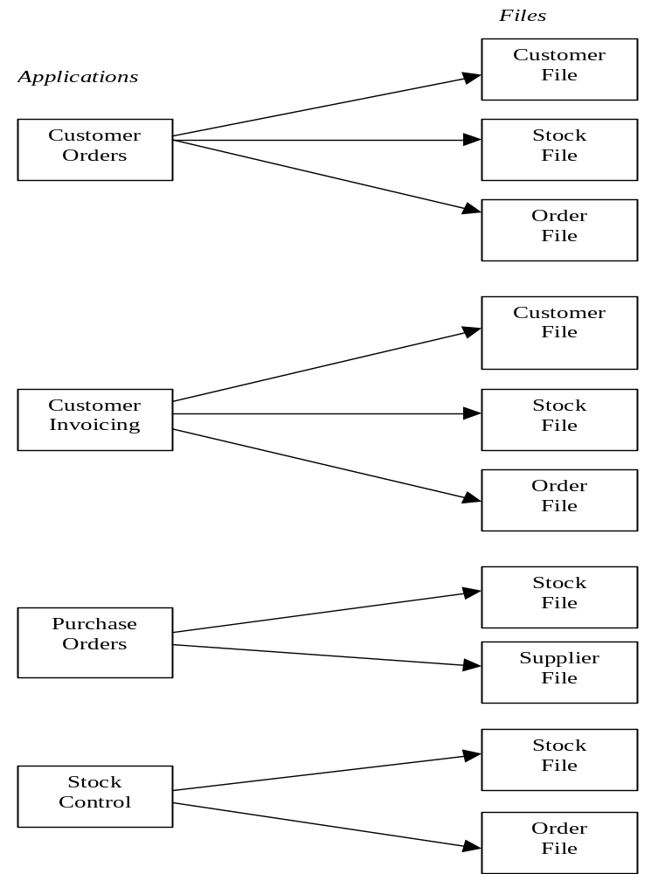
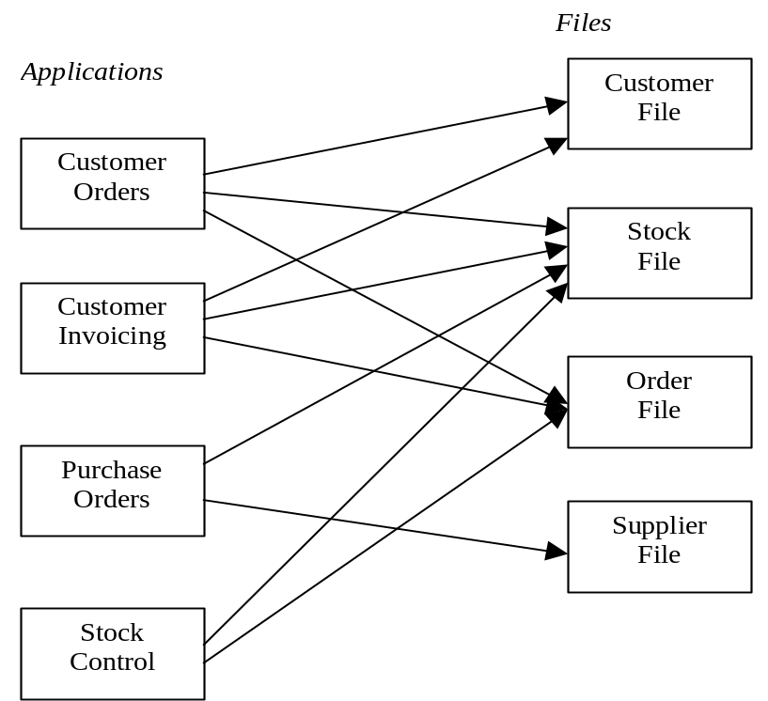
Introduction
File-based approach
Shared file approach

Slide 16
Introduction
Database approach
  DataBase Management System (DBMS): a general-purpose software system that facilitates the processes of defining, constructing, manipulating, and sharing databases among various users and applications.
  Database: a collection of related data managed by a DBMS
  Data: known facts that can be recorded and that have implicit meaning
  Database system = the database + DBMS software
  DBMS provides facilities for querying, data security, and integrity and concurrent control
  Database application - set of programs that use DBMS to perform a particular business function

Slide 17
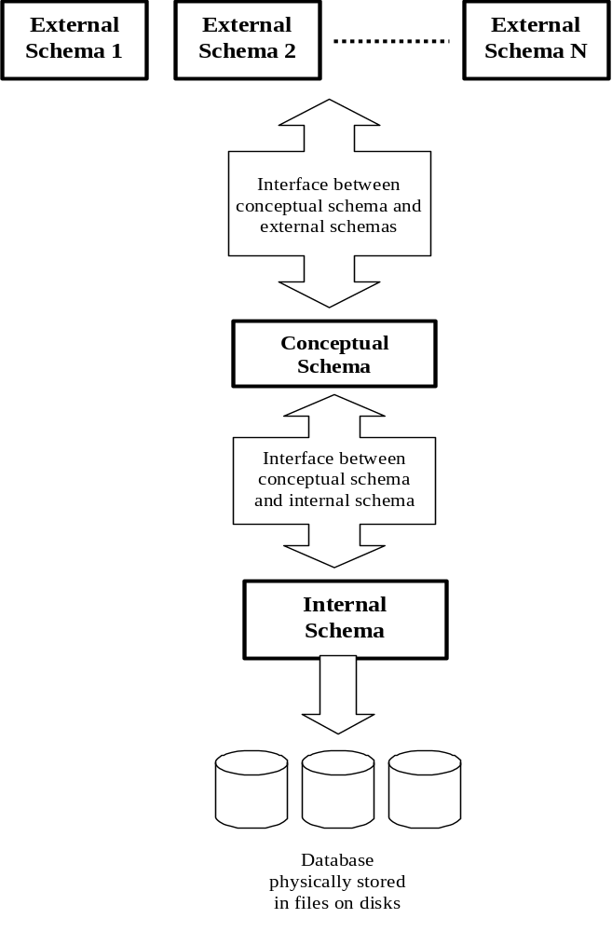
Introduction
Database approach
  Advantage - physical and logical data independence - achieved by hierarchy of levels of data specification

Slide 18
Introduction
Database approach
  External schema:
    Describes database as it is seen by user and applications -reflects a simplified model of the world
    Allows applications to see as much of data as they require, while excluding unrelated data items
    Interfaces with conceptual schema
    May be modified or created without altering physical storage of data, modification reflected in the interface

Slide 19
Introduction
Database approach
  Conceptual schema:
    Describes the universe of interest to the users of the database system - data required
    Concerned with data rather than storage or access, concentrates on describing entities, data types, relationships, user operations, and constraints
    Interfaces with external and internal schema
    Logical data independence is the capability to change the conceptual schema without having to change external schemas or application programs

Slide 20
Introduction
Database approach
  Internal schema:
    Definition of the way in which data is physically stored
    Interface with conceptual schema identifies how an item in the conceptual schema is stored and accessed
    Physical data independence is the capability to change the internal schema without having to change the conceptual schema. Hence, the external schemas need not to be changed as well

Slide 21
Introduction
DBMS components
  DBMS engine - central component
  User interface - languages & interfaces
  Data dictionary - data structure, user & access right, rules
  Performance management - query optimisation & DBMS reorganisation
  Data integrity - intra-record, referential integrity & concurrency
  Backup and recovery - log
  Application development - CASE tool
  Security management - protect and control access to database & data dictionary

Slide 22
Introduction
Characteristics of the database approach
  Self-describing nature of a database systems
  Insulation between programs and data, and data abstraction
    Program-data independence + Program-operation independence = Data abstraction
    A data model is a type of data abstraction
  Support of multiple views of the data
  Sharing of data and multi-user transaction processing
  Other advantages of using the DBMS approach
    Controlling redundancy
    Restricting unauthorized access
    Providing persistent storage for program objects
    Providing storage structures for efficient query processing
    Providing backup and recovery

Slide 23
Introduction
Characteristics of the database approach
  Other advantages of using the DBMS approach (cont.)
    Providing multiple user interfaces
    Representing complex relationships among data
    Enforcing integrity constraints
    Permitting inference and actions using rules: deductive database systems

Slide 24
Introduction
Extending database capabilities for new applications
  Example applications: storage and retrieval of images, videos, data mining (large amounts of data need to be stored and analyzed), spatial databases, time series applications, …
  More complex data structures than relational representation
  New data types except for the basic numeric and character string types
  New operations and query languages for new data types
  New storage and retrieval methods

Slide 25
Relational Data Model
Basic concepts
  Relational data model: represents a database in the form of relations - 2-dimensional table with rows and columns of data. A database may contain one or more such tables. A relation schema is used to describe a relation
  Relation schema: R(A1, A2,…, An) is made up of a relation name R and a list of attributes A1, A2, . . ., An. Each attribute Ai is the name of a role played by some domain D in the relation schema R. R is called the name of this relation. The degree of a relation is the number of attributes n of its relation schema.
  Domain D: D is called the domain of Ai and is denoted by dom(Ai). It is a set of atomic values and a set of integrity constraints
    STUDENT(Name, SSN, HomePhone, Address, OfficePhone, Age, GPA)
    Degree = ??
    dom(GPA) = ??

Slide 26
Relational Data Model
Basic concepts
  Tuple: row in table, record
  Cardinality: number of tuples (rows)
  Database schema S = {R1, R2,…, Rm}
  A relation (or relation state, relation instance) r of the relation schema R(A1, A2, . . ., An), also denoted by r(R), is a set of n-tuples r = {t1, t2, . . ., tm}. Each n-tuple t is an ordered list of n values t = <v1, v2, . . ., vn>, where each value vi, i=1..n, is an element of dom(Ai) or is a special null value. The ith value in tuple t, which corresponds to the attribute Ai, is referred to as t[Ai]
  Relational data model
  Database schema
  Relation schema
  Relation
  Tuple
  Attribute

Slide 27
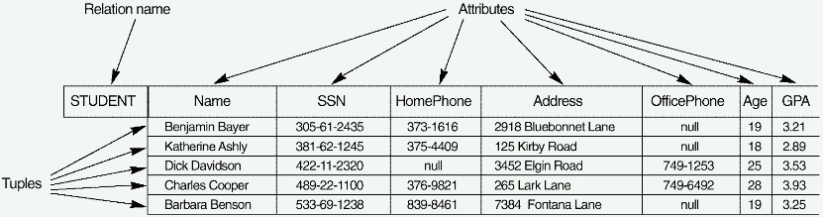
Relational Data Model
A relation can be conveniently represented by a table, as the above example shows
The columns of the tabular relation represent attributes
Each attribute has a distinct name, and is always referenced by that name, never by its position
Each row of the table represents a tuple. The ordering of the tuples is immaterial and all tuples must be distinct

Slide 28
Relational Data Model
Relational Data Model Constraints
  Key, primary key & foreign key
    Key: A key K of a relation R is a subset of the attributes of R which has the following time-independent properties:
      Unique identification: The value of K must uniquely identify each tuple in R
      Non-redundancy: No attribute in K can be discarded without destroying property 1
    Primary Key: There may be more than one set of attributes which satisfy both properties. Each of them is called a candidate key. In this case only one candidate key must be chosen as the key called primary key. Primary key (PK) cannot contain null value

Slide 29
Relational Data Model
Relational Data Model Constraints
  Key, primary key & foreign key
    Single primary key:
      TASK (TASK_NAME, START_DATE,EXPECTED_COMP_DATE, COMP_DATE, EMPNO)
    Combined primary key: If we want to store in the task table, the details of tasks for a number of different projects, TASK_NAME is no longer a unique identifier. The solution is to use a further attribute to provide a unique identifier for each task.
      TASK (PROJECT_NAME, TASK_NAME, START_DATE, EXPECTED_COMP_DATE, COMP_DATE, EMPNO)

Slide 30
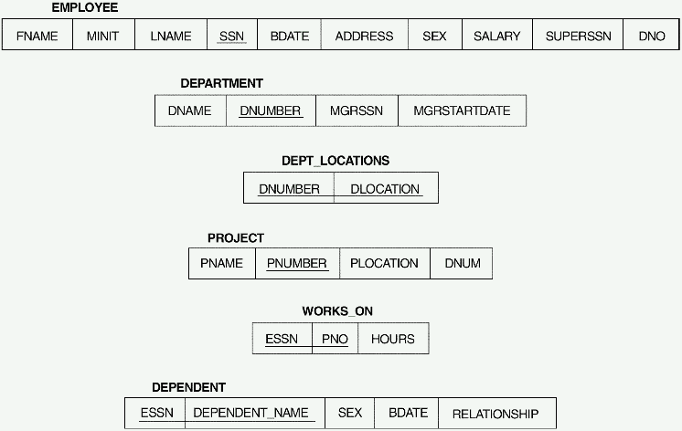
Relational Data Model
Example: A relational database schema that we call COMPANY = {EMPLOYEE, DEPARTMENT, DEPT_LOCATIONS, PROJECT, WORKS_ON, DEPENDENT}

Slide 31
Relational Data Model
Relational Data Model Constraints
  Entity Integrity Constraint: all entities in a database must be identified by the primary key. That is why NO primary key value can be null
  Referential Integrity Constraint: The value of a foreign key must be meaningful, which means that a tuple in one relation that refers to another relation must refer to an existing tuple in that relation
  Example: JobList and Company tables (see notes for labs)
JobList
JobID CompanyID JobTitle Salary ….
Company
CompanyID CompanyName Address ...

